Slide 1

PREDICTIVE MODELING OF FETAL HEALTH STATUS USING MACHINE LEARNING ALGORITHMS
UNDER THE GUIDANCE OF PROF. Dr. WEIHUA ZHOU

Slide 2
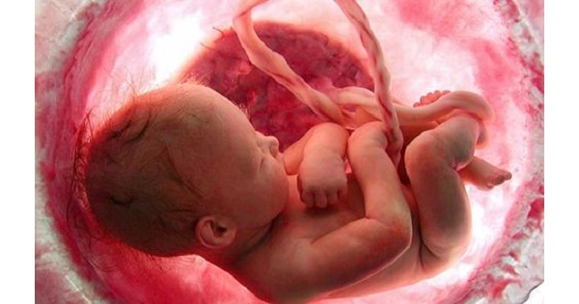

6.3 million…

Slide 3
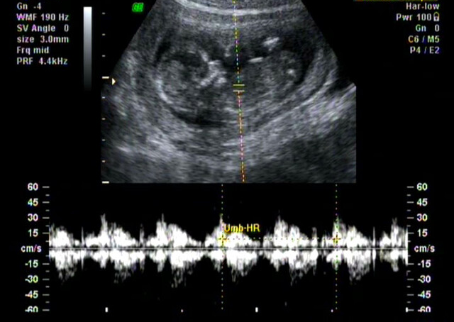
Fetal health classification based on a cardiotocography (CTG) dataset

Slide 4
Dataset
2126 records of features extracted.
A total of 22 features considered
Classified into 3 classes
Upon reviewing the dataset, what aspects or characteristics stand out?

Slide 5
Dataset
Multiclass Classification
Highly imbalanced data
Upon reviewing the dataset, what aspects or characteristics stand out?

Slide 6
STEPS IN DATA ANALYSIS
Set up features(X) and target (y)
Scale the features
Splitting to train and test sets
Model Selection
Hyperparameter Tuning
SO,
DATA CLEANING IS NOT MANDATORY?

Slide 7
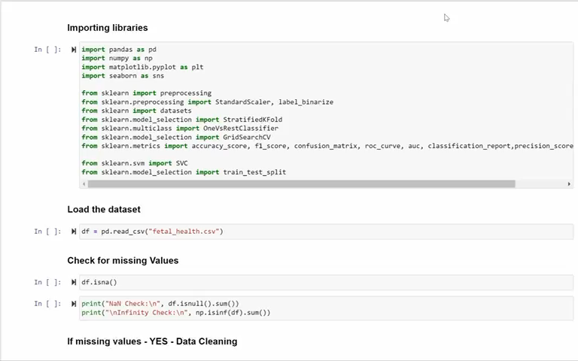

Slide 8
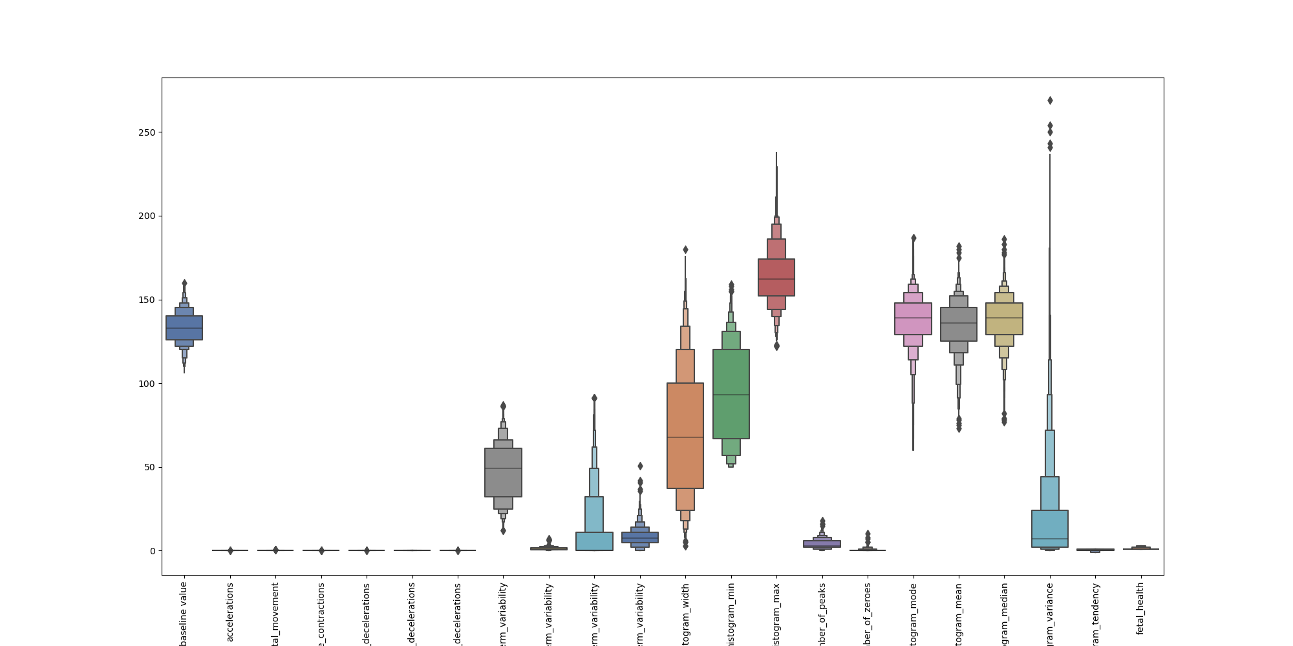
Range of Feature Attributes

Slide 9
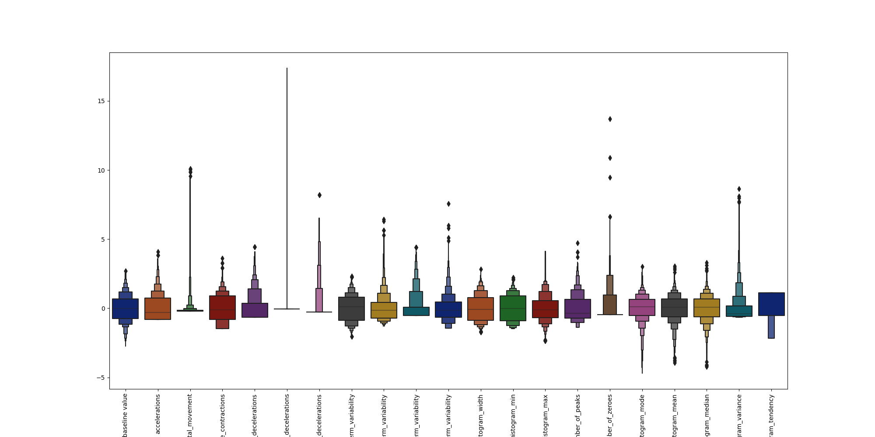
After Feature Scaling ……

Slide 10
Splitting Dataset
TRAINING
DATASET
(80%)
TOTAL DATASET
(2126)
TESTING
DATASET
(20%)
X_train, X_test, y_train, y_test = train_test_split(X, Y, test_size=0.2, random_state=42)

Slide 11
MODELS SELECTED FOR THIS CLASSIFICATION
1. Support Vector Classification | 2. Random Forest
3. Adaboost Classifier
IMBALANCED DATA
Stratified cross validation
class weighting
HYPERPARAMETER TUNING
Grid Search

Slide 12
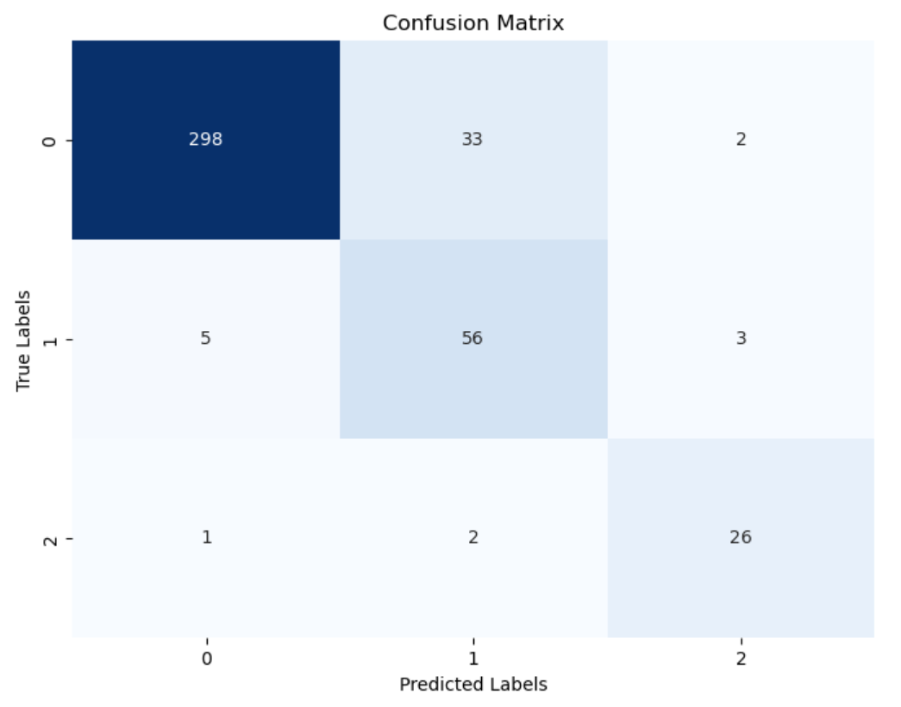
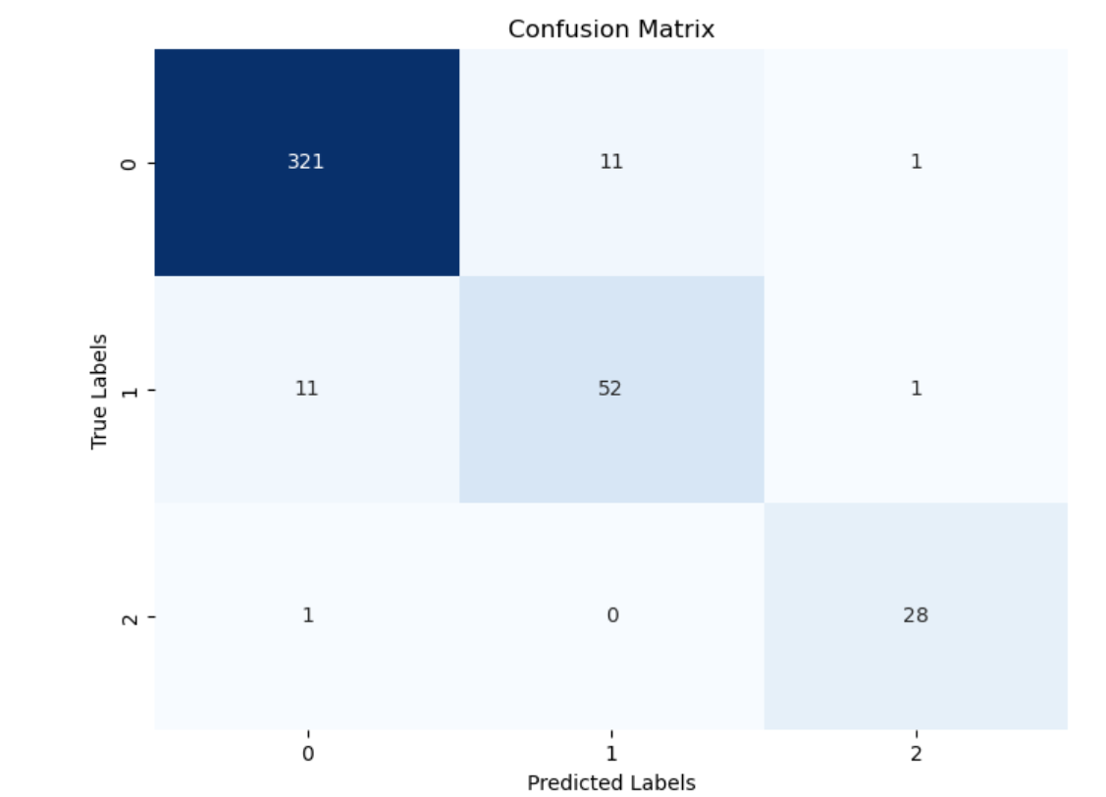
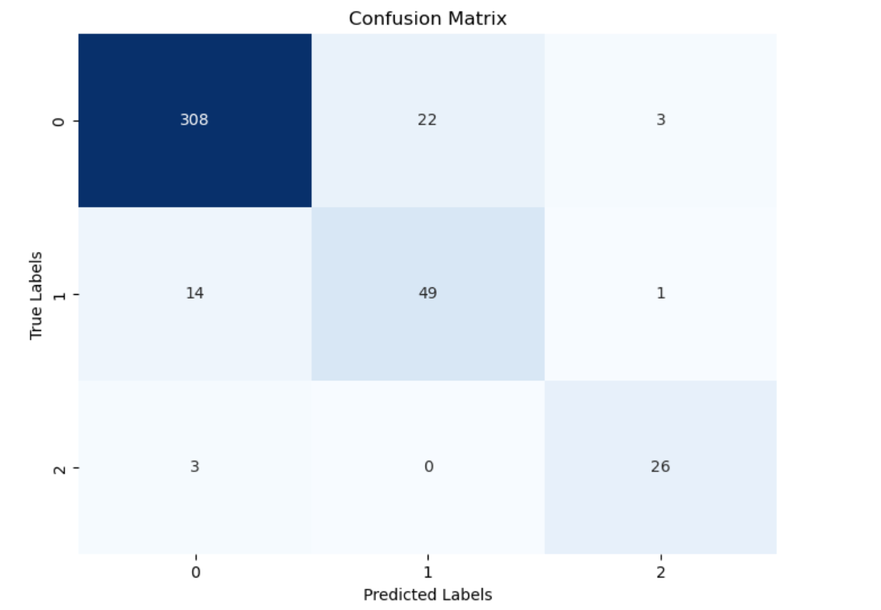
METRICS
MODEL | TRAINING ACCURACY | TESTING ACCURACY
Support Vector Classification | 0.94 | 0.89
Random Forest | 0.98 | 0.94
Adaboost | 0.92 | 0.89
Among three classifiers, RF achieved the highest accuracy.
SVC
RF
Adaboost

Slide 13
Random Forest Metrics
(Nested Cross Validation)
Round 1:
Average Training Accuracy (Inner Cross-Validation): 0.93
Testing Accuracy (Outer Test Set): 0.93
Round 2:
Average Training Accuracy (Inner Cross-Validation): 0.93
Testing Accuracy (Outer Test Set): 0.94
Round 3:
Average Training Accuracy (Inner Cross-Validation): 0.93
Testing Accuracy (Outer Test Set): 0.95

Slide 14
IF none of the above followed –
No hyperparameter tuning,
No CV,
No class weight
Then the metrics:
Imagine a
Scenario
Training Accuracy - 100%
Testing Accuracy - 89%
This is Overfitting…

Slide 15

REFERENCES
Kuzu A, Santur Y. Early Diagnosis and Classification of Fetal Health Status from a Fetal Cardiotocography Dataset Using Ensemble Learning. Diagnostics (Basel). 2023 Jul 25;13(15):2471. doi: 10.3390/diagnostics13152471. PMID: 37568833; PMCID: PMC10417593.
Dataset: Campos,D. and Bernardes,J.. (2010). Cardiotocography. UCI Machine Learning Repository. https://doi.org/10.24432/C51S4N
Any Questions?

Slide 16

THANK YOU
V Susmitha Bommini
Anjum A Shaik

